Slide 1
Fairly Odd parents,simpson,
Spongebob squarepants and others discrimination
Valentina Lopomo
Student
Angel Watler
Teacher
Colegio Bennett
Social studies
5-a
2010-2011

Slide 2
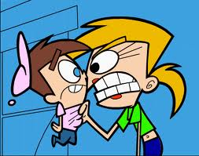
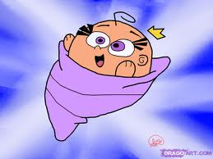
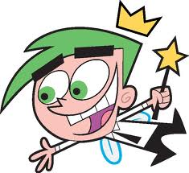


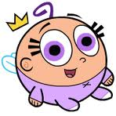
VICKY! YOU ARE DISCRIMINATING TIMMY
YOU ARE A STUPID BOY
YES! HE IS RIGHT BUT TELL US ABOUT THE DISCRIMINATION
Ok I will tell you! Discrimination is to treat others bad because they are different or has problems in their physic part.
Wanda can you please tell us what are them
It also has types but tell Wanda to tell what are those types
The types are race, ethnic, religious, disability, sexual, and gender
Disability: is when they discriminate others because someone has a problem in their bodies.
Sexual: when people is discriminated because they are gay,etc.
Gender: when mens or women discriminate a women or men because they think they are best.
Race: is when people discriminate others because of their color .
religious: is when they discriminate others because of their believes.
Ethnic: is when others discriminate people because they come from different parts.

Slide 3
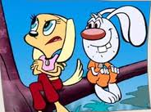
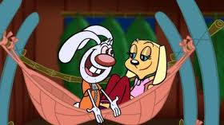
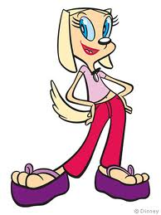
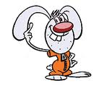
Later………….
I know what it is and i would explain you! Let´s go home and I tell you
Everybody knows who are the discriminated people but i don´t!!
Brandy! The discriminated people are the ones that are victims from bad words that others say..
The ones that are afroamericans are discriminated people is u.s.a there are other types of people,too.
Do you understand???
Yes and thanks for teach me about that

Slide 4
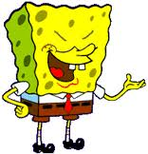
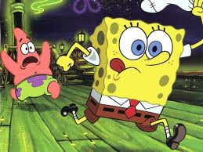
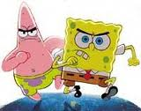
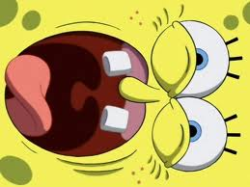
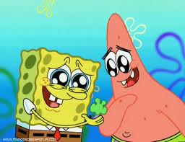
Patrick is very stupid and has a gay pink color.
What did you say??? I don’t have a gay pink color respect me please….
I didn´t say that, my mouth said it.
Oh!! So know i´m not going to kick you my leg is going to do it
Stoop!!
Oh excuse me for saying that! I don´t want to discriminate you. Look i have these for you. Can we be best friends again??
Ok best friends for ever!! And thanks for that spectacular gift.

Slide 5
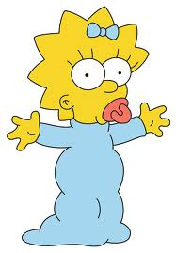
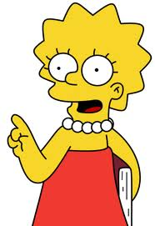
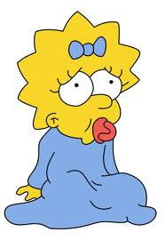
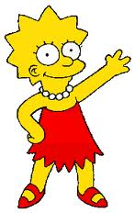
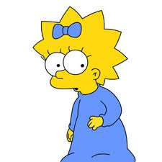
DON´T SAY THAT. DISCRIMINATION IS BAD
I THINK MY DAD IS VERY FAT!!!!
JAJA
Oohh!! But why it is bad??
Ok thanks for let me learn something new todat! I will not do it again
Because you are telling bad things about people
THE END

